Slide 1

Item 15: Use constexpr whenever possible.
Scott Meyers - Effective Modern C++
Presented By
@7eRoM

Slide 2
constexpr indicates a value that’s not only constant, it’s known during compilation.
They may be placed in read-only memory.
Integral values that are constant and known during compilation can be used in contexts where C++ requires an integral constant expression.
Such contexts include specification of array sizes, integral template arguments (including lengths of std::array objects), enumerator values, alignment specifiers, and more.
All constexpr objects are const, but not all const objects are constexpr.

Slide 3
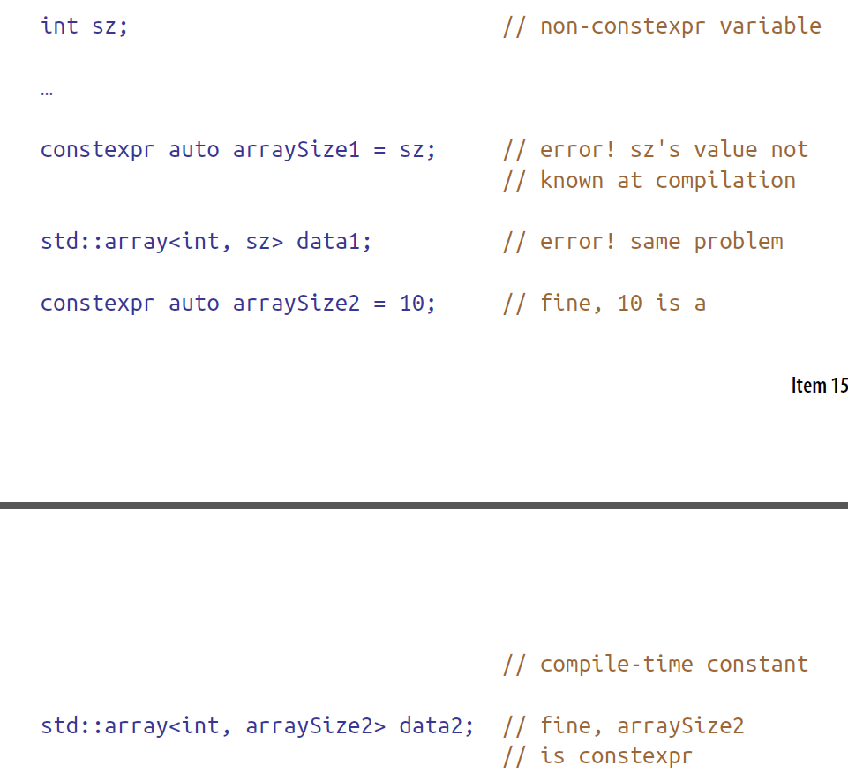
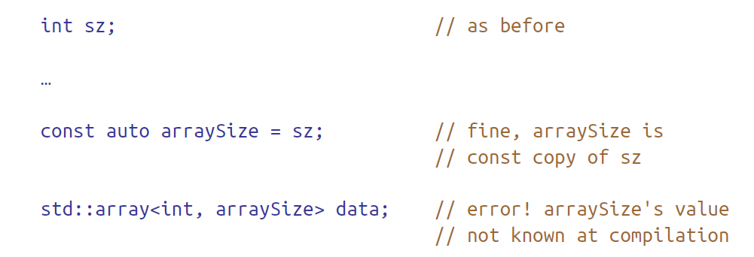

Slide 4
When a constexpr function is called with one or more values that are not known during compilation, it acts like a normal function, computing its result at runtime. This means you don’t need two functions to perform the same operation,
Example: we need a data structure to hold the results of an experiment that can be run in a variety of ways
The lighting level can be high, low, or off
If there are n environmental conditions relevant to the experiment, each of which has three possible states, the number of combinations is 3^{n}
Storing experimental results for all combinations of conditions thus requires a data structure with enough room for 3^{n} values
we’d need a way to compute 3^{n} during compilation
std::pow is the mathematical functionality we need, but, there are two problems:
std::pow works on floating-point types, and we need an integral result.
std::pow isn’t constexpr

Slide 5
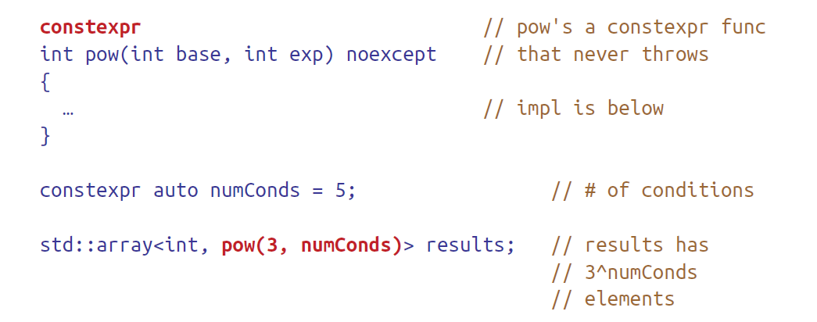
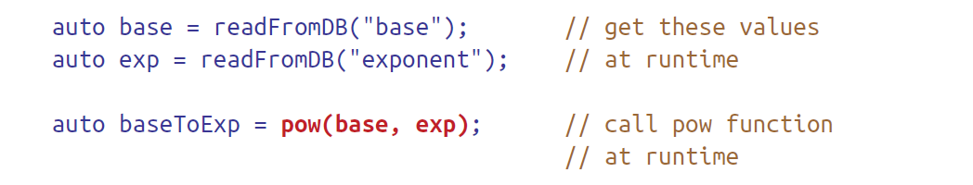
If base and/or exp are not compile-time constants, pow’s result will be computed at runtime.

Slide 6
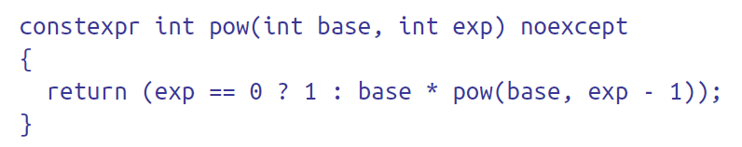
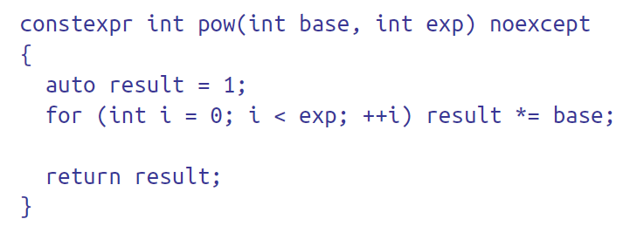
In C++11, constexpr functions may contain no more than a single executable statement: a return
In C++14, the restrictions on constexpr functions are substantially looser

Slide 7
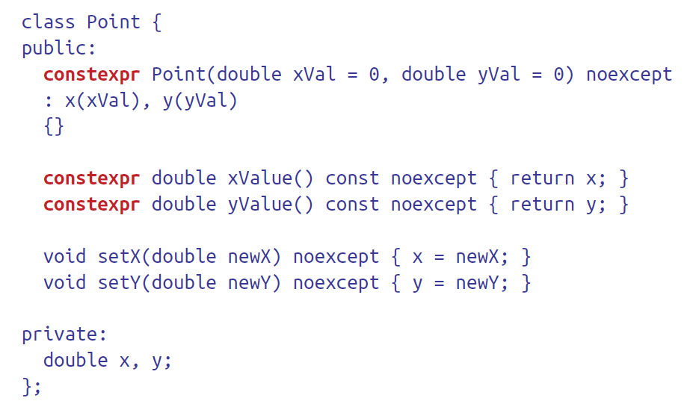
constexpr functions are limited to taking and returning literal types. It means the types that can have values determined during compilation
In C++11
all built-in types except void qualify
user-defined types may be literal, because constructors and other member functions may be constexpr

Slide 8
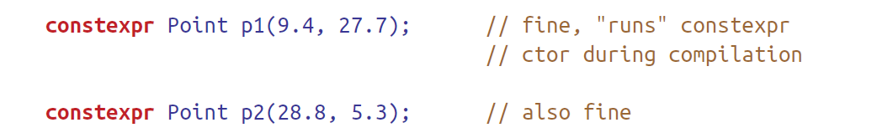
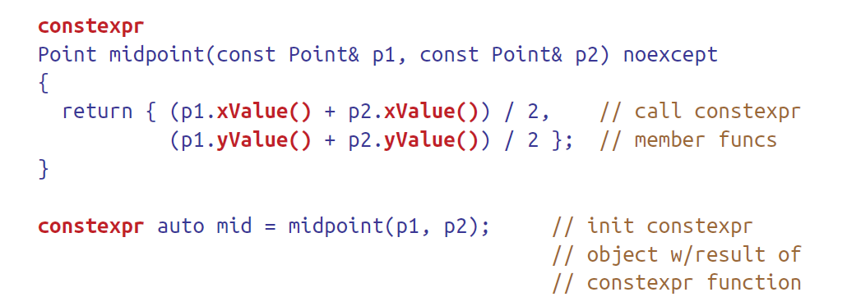
Points so initialized could thus be constexpr
The getters xValue and yValue can be constexpr
It is possible to write constexpr functions that call Point’s getters and to initialize constexpr objects with the results of such functions:

Slide 9
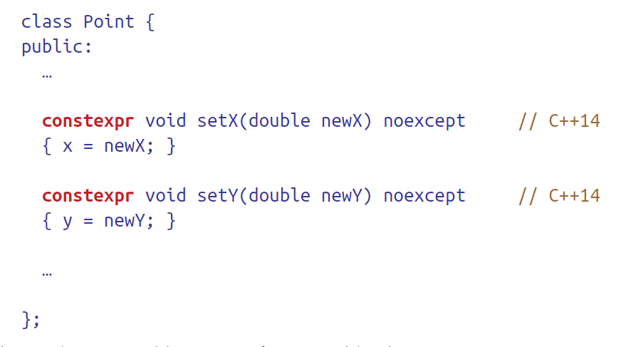
In C++11, two restrictions prevent Point’s member functions setX and setY from being declared constexpr:
they modify the object they operate on, and in C++11, constexpr member functions are implicitly const
they have void return types, and void isn’t a literal type in C++11.
Both these restrictions are lifted in C++14

Slide 10
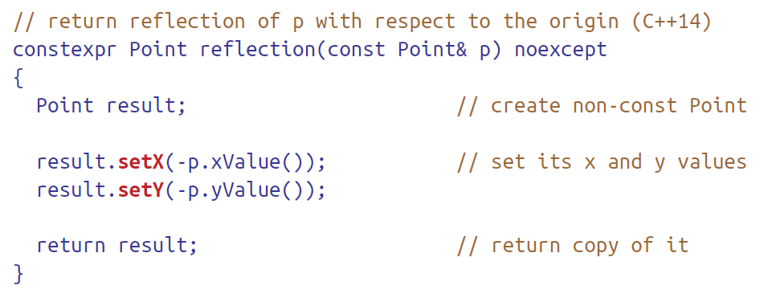
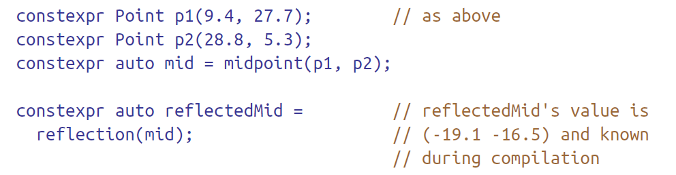
That makes it possible to write functions like this:
Client code could look like this:

